Slide 1
Pelvic Health Physiotherapy Role in Maternal birth injury
Includes what ACC covers for Post natal physio and what IT doesn’t
Jill Wood & Tania Mclean
Pelvic HEALTH physiotherapists
www.nzpelvicphysio.com

Slide 2
ACC Maternal birth injury (MBI) cover
ACC contributes towards physiotherapy treatment for specific maternal birth injuries that occur on or after 1 October 2022
Physio submits an ACC45 form with read code & identifies injury type acc.co.nz/maternalbirthinjuries for details
Surcharges vary at physiotherapy practices – ACC contract dependent
Hospital outpatient pelvic physiotherapy clinics
free of charge, waitlists for appointments vary, ? classes initial contact
Notes:
Ensure patient IF REFERRED AWARE THERE IS A SURCHARGE
Mention midwives have prob already been involved with filling forms and lodging claims
Brigid Beehan on the midwifery advisor group for MBI for Tamaki Makarau – can answer any of your queries

Slide 3
Pelvic health physiotherapists can lodge claims for these injuries
Notes:
Physio covers and can lodge a claim for all the boxes highlighted in blue – we are going to focus on the areas highlighted in yellow as specific to pelvic health physio
Coccyx, pubic ramus fractures, & symphysio pubis capsule tears can be treated by normal Musculo skeletal physios

Slide 4
PHYSIO is not covered BY ACC when
Bladder or bowel symptoms in the absence of an MBI
Musculo skeletal pain & symptoms in the absence of an MBI
e.g back & neck pain , carpal tunnel, De Quervains
Diastasis recti
Abdominal muscle weakness
An injury is covered not a symptom
Notes:
Carpal tunnel syndrome (CTS) is an entrapment or compression of the median nerve at the wrist as it passes through the carpal tunnel.^{[1]} It is the most common compressive neuropathy and is more common in females.^{[2]} Symptoms occur in the thumb, index finger, middle finger and the radial half of the ring finger.
De Quervain's Tenosynovitis
is a painful, inflammatory condition caused by tendons on the side of the wrist at the base of the thumb. Pain, which is the main complaint, gets worse with abduction of the thumb, a grasping action of the hand, and an ulnar deviation of the wrist. Thickening and swelling can also be present. ^{[1]} ^{[2][3]}

Slide 5
Diastasis recti
Notes:
Diastasis recti (rectus diastasis) or divarication of the recti is a stretching of the linea alba with abnormal widening of the gap between the two medial sides of the rectus abdominis muscle

Slide 6
Pelvic Floor Dysfunction
Fascial defects – leading to prolapse (POP)
Muscle injuries – partial or complete levator avulsion
Neural injuries due to overstretch, compression, tears – pain, denervation and muscle weakness
Diminished blood supply - ischaemia –pain
Haematoma
Notes:
Vaginal birth - damage PF muscles, nerves, blood vessels, fascia, tissue, weaken & stretch pelvic organ support structures, changes to mobility of the PF and bladder neck position
Pregnancy effects – weight weakens PF, hormonal changes l laxity of fascial support, stretch to peripheral nerves
40-80% of vaginal births - denervation to pubvisceral muscles and anal sphincter. -Pelvic floor damage and childbirth: a neurophysiological study. Allen RE et al, BJOG. 1990;97(9):770
S2,S3,S4 (pudendal nerve) innervates EAS
S2,S3,S4 (direct innervation) - levators, coccygeus, urogenital diaphragm
Delivery – stretching, compression causes demyelination denervation.
Neural damage appears to resolve over the first year after delivery.

Slide 7
Symptoms of Pelvic Floor dysfunction
Bladder-Urinary incontinence, urinary urgency, urinary frequency, voiding changes
Bowel- Faecal incontinence, faecal urgency , obstructed defecation
Support Issues- POP, pelvic floor muscle weakness (PFM) or overactivity
Sexual function- dyspareunia, POP, PFM weakness/overactivity
Pain – scar tissue
Notes:
Patient issue may be….
can’t hold it in
bladder/bowel incontinence, pelvic organ prolapse
can’t get it out
bladder incomplete empty, difficult defecation
Cant feel it
Pain

Slide 8
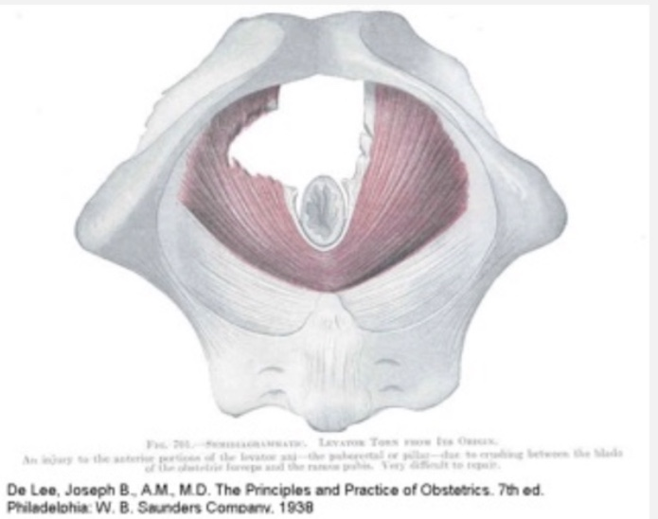
Levator Avulsion
Disconnection of pelvic floor muscle from inferior pubic ramus and pelvic side wall associated with vaginal delivery
Unilateral or bilateral, partial or complete
Impacts levator hiatal dimensions
Notes:
RISK FACTORS for levator trauma: PROTECTIVE Factors:
Antepartum - low BMI – only risk factor for LA - Epidural – (OR 0.42, 95% CI 0.19-0.93)
(Episiotomy - no significant protective effect)
OASIS (OR 8.1, 95% CI 3.3-19.5)
Prolonged active second stage
Forcep delivery (OR 2.45, 95%CI 1.04-5.8)
Ventouse – not associated with LAM avulsion. (OR 0.9, 95% CI 0.19-4.3)
Increased maternal age

Slide 9
Levator Avulsion (LA)
Episiotomy - no significant protective effect
Epidural has a protective effect
RISK FACTORS for levator trauma:
Antepartum - low BMI
OASIS
Prolonged active second stage
Forceps delivery
Increased maternal age
Ventouse – not associated with LA avulsion
Notes:
>33 years at delivery – (Low et al 2014)
First vaginal delivery – (15-36%)
Forceps delivery
Longer second stage of labour >110- 150 mins
Higher birth-weight babes
Large fetal head circumference > 35.5
Occiput posterior delivery
Post natal hematoma
OASIS
Pre-natal Low BMI
Dietz & Lanzerone 2005,
Delivery mode, levator avulsion and obstetric anal sphincter injury: A cross‐sectional study 20 years after childbirth Sylvia Lin , Hans Peter Dietz, Peter Donald Wilson 21 February 2019, https://doi.org/10.1111/ajo.12948
Volløyhaug I, et al. Forceps delivery is associated with increased risk of pelvic organ prolapse and muscle trauma: a cross‐sectional study 16–24 years after first delivery. Ultrasound Obstet Gynecol 2015; 46: 487–495.
Caudwell Hall j et al. Intrapartum predictors of maternal LA injury. AOGS, Jan 2017. https://doi.org/10.1111/aug.13103
Cassado J et al. Does episiotomy protect against injury of the levator ani muscle in normal vaginal delivery. Neurourology UDS 2014:33.1212-1216.

Slide 10
Maternal recovery from labour and delivery: Bone and levator injuries:
68 women with risk factors for LA – long second stage, anal tear and older age
MRI at 7 weeks and 8 months
RESULTS – 66% pubic bone marrow oedema
- 29% subcortical fractures Complete resolution 8/12
- 90% LA oedema
- 41% LA tear at 7 weeks, unchanged at 8 months.
Miller J, Delancy J. Evaluating maternal recovery from labour and delivery; bone and levator injuries AJOG, August 2015, research gynaecol 213(2): 188.
Notes:
1st vaginal birth
Bony abnormalities resolve – but not the levator tear does not
assoc with levator weakness

Slide 11
Levator Avulsion - long term impact
Doubles the risk of bladder POP
Triples the risk of uterine POP
Triples the risk of POP return post pelvic surgery
Links with incontinence and sexual function are less clear
Major LA defects in 55% of women seeking POP Rx
Dietz & Simpson 2008, Dietz 2016, Rane 2017

Slide 12
PELVIC floor Muscular supports
Puborectalis Pubococcygeus Illiococcygeus Coccygeus
I-------------------- Levator Ani complex-----------I
Notes:
These pelvic floor muscules support and preserve integrity of the pelvic organs. Disruption, denervation and atrophy with parturition disrupt this integrity. Genital hiatus is the hollow area between the puborectalis muscles.

Slide 13
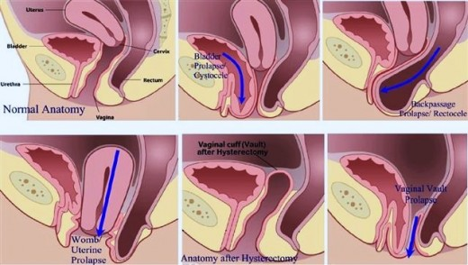
Notes:
Descent of 1 or more of the anterior, posterior vaginal wall or cervix
Dragging low back pain
Sense of bulge heaviness worse after =defecation/end of day
Stages relate to correlation with hymen
Stage 1- leading edge more than 1 cm above hymen
Stage 2 leading edge between 1 cm above and 1 cm below hymenstage 3 leading edge more than 1 cm below hymen but 2 cms shorter than total vaginal length
Stage 4 complete eversion

Slide 14
Prolapse (POP)
1 in 3 women will have POP stage 2-3
( level with vaginal entrance and beyond)
50% some degree of prolapse mild or asymptomatic at risk of worsening with certain exercise
1 in 9 will need surgery
Increases with age – Age 70 (1 in 6), Age 80 ( 1 in 5)
33 % that have surgery will require repeat surgery
Notes:
Risk factors for prolapse– vaginal delivery- familial history
Chronic straining eg – constipation heavy lifting / chronic cough
hypermobility/obesity age

Slide 15
Tears
perineum, labia, vagina, vulva
clitoris, cervix, rectum, anus, urethra
Obstetric anal sphincter injury tears
Notes:
All can cause pain and or dysfunction– varying degrees but focus tonight is on OASIS

Slide 16
Obstetric anal sphincter injuries (OASIs) 3rd & 4th degree
Damage from irreversible overdistension to
muscles, connective tissue, nerves , blood supply
Symptoms
Short/medium term- pain/discomfort/faecal urgency/incontinence
Long term – ongoing incontinence, pain, dyspareunia
Symptoms may not present til 20 + years
Notes:
Implications depend on tissue healing & repair

Slide 17
Notes:
Faecval incont has huge social implications and can turn patient into social recluse

Slide 18
Clinical implications
Bladder & Bowel - Incontinence, urinary & or faecal & or flatus, difficulty emptying, urgency & frequency, pain
Reduced Structural Supports - Prolapse risks, incontinence risks
Sexual Dysfunction – Pain/ dyspareunia, reduced sensation, incontinence
Pelvic Pain
Exercise participation– effect of intra abdominal pressure on PFM & structural supports
Psychological effects

Slide 19
PHYSIO Assessment FOR PELVIC FLOOR ISSUES
Subjective assessment – bladder, bowel, sexual function, pain, ADL, mood, exercise levels
Vaginal Pelvic floor muscle (PFM) exam - prolapse, levator avulsion, muscle function- weak /tight, scar tissue, pain, perineal anatomy changes
Abdominal muscle exam
Rectal PFM exam in some cases

Slide 20
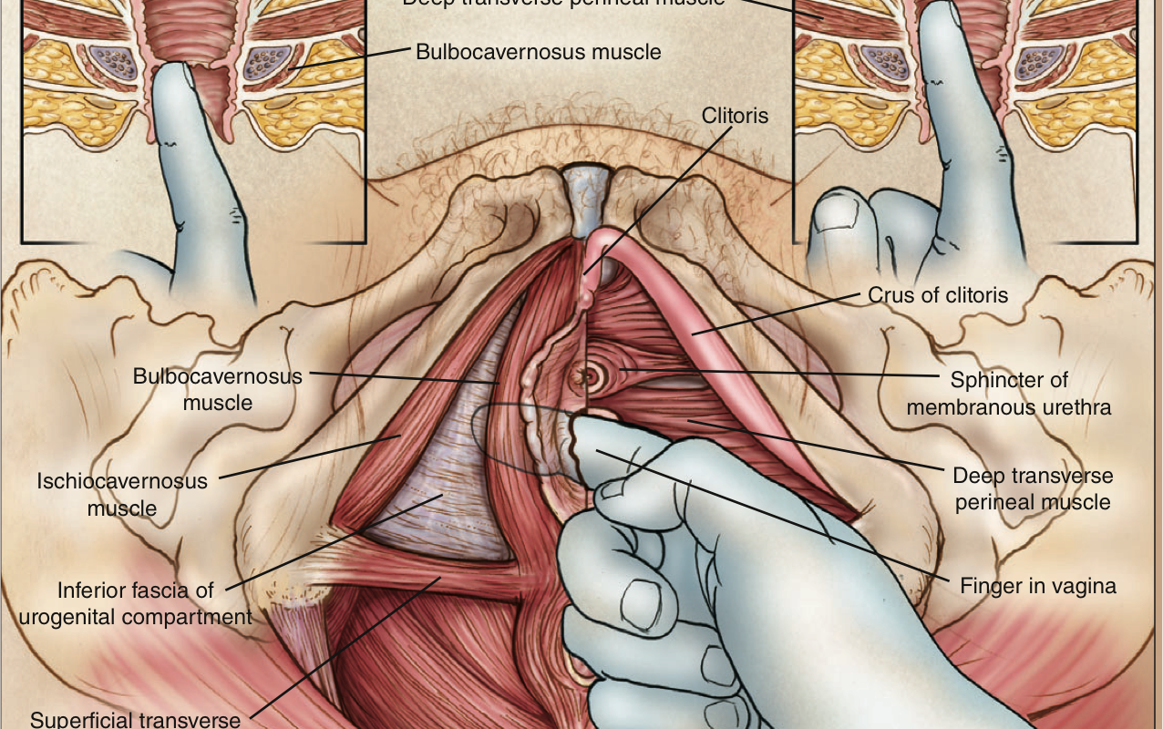

Slide 21
Treatment may include
Education
Lifestyle & activity modification
Toileting techniques, bladder & bowel retraining
Pelvic Floor Muscle training – Up train, down train, functional goal focus
Biofeedback, electrotherapy
General exercise prescription
Manual therapies

Slide 22
Consider the gravitational effect of exercise
Notes:
We need to condider the recovery period and what women are doing post natally some exs may be detrimental and have long term consequences for their uro gynae health

Slide 23
Postnatal Balance between benefits of general exercise & protecting an underactive at risk Pelvic Floor
Pros
Cons
Notes:
women do not understand the risks of long distance running, of heavy weights, they think women and men are the same
Weigh up the risks for that particular person of a particular exercise versus the benefits of exercise
Benefits are huge – keep in balance so don’t effect other aspects of life

Slide 24
Goals of post natal physio treatment
Return to normal bladder bowel & sexual function
Return to ADL & safe exercise
Enable women to be able to care for her babe, children, self
Notes:
In conjunction with patient goals

Slide 26
Pelvic Floor risk factors are multifactorial
Childbirth - High parity, vaginal deliveries, forceps, > LSCS | Already weak pelvic floor
High impact sport – jumping, running, trampoline | Chronic strain – lift, constipation, occupational
Increasing age – lowering tone menopause | Obesity – large waist circumference
Diabetes – poor vascular & nerve supply to pelvic muscles | Pelvic surgery eg Hysterectomy
Genetic – poor collagen | Respiratory- coughing
Notes:
predisposing- Genetics, race, gender, connective tissue disorders. POP Caucasians > African-Americans, females> males.
Inciting events - pregnancy and delivery, surgery such as hysterectomy, myopathy or neuropathy.
Promoting factors- obesity, smoking, pulmonary disease, constipation, lifestyle activities such as frequent or heavy lifting.
Decompensating - Aging, menopause, neuropathy, myopathy, debilitation, medication. (Bump 1998)
The Women's Health Initiative found that almost one fifth of nulliparous women had a prolapse of some degree (Hendrix, 2002), negating nulliparity as a means of prevention. According to the Women's Health Initiative a body mass index greater that 30 kg/m2 gives a 40-75% increased risk of prolapse (Hendrix, 2002).

Slide 27
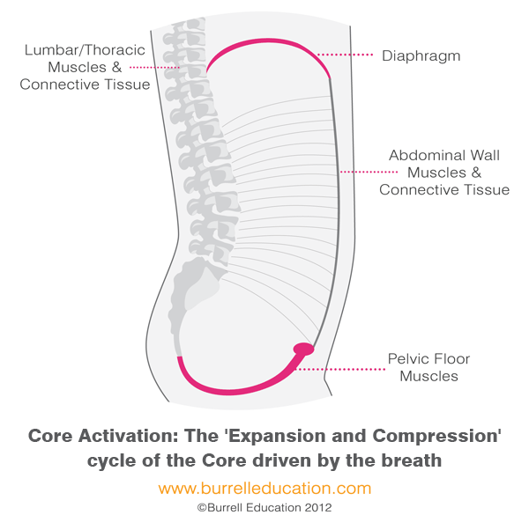
Notes:
At rest
Balloon concept
Pelvic floor does not function in isolation
Initial stages of pfm retraining is the coordination of action of diaphragm, tran ab
Next stage is the sustained hold of pfm action while breathing continues

